Slide 1
Mass-Mail Dispatcher
Name – Ayush Gupta
College Name – Kashi institute of technology
Mirzamurad,Varanasi.
Branch – Computer Science Engineering
Project name – Mass mail dispatcher

Slide 2
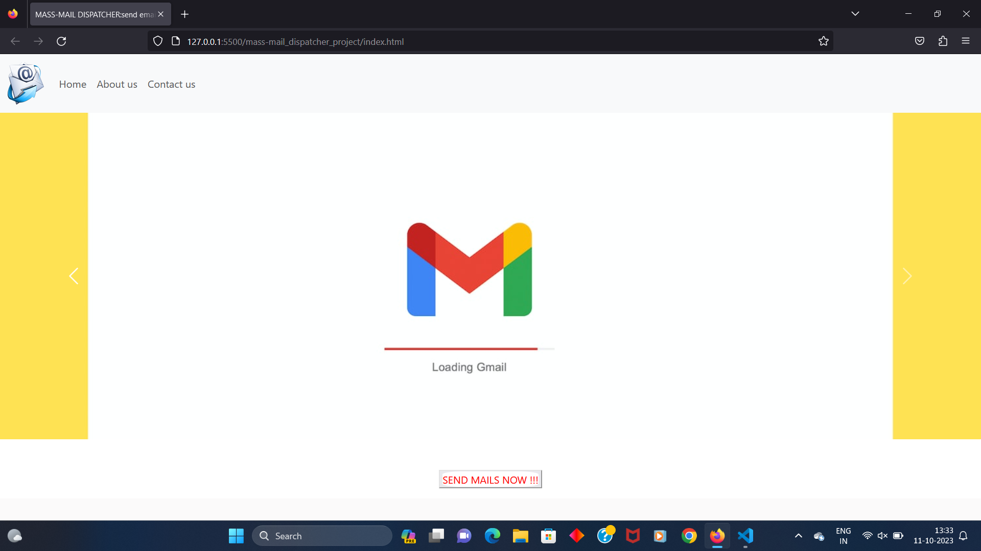
Starting page with navigation bar , slider and footer.

Slide 3
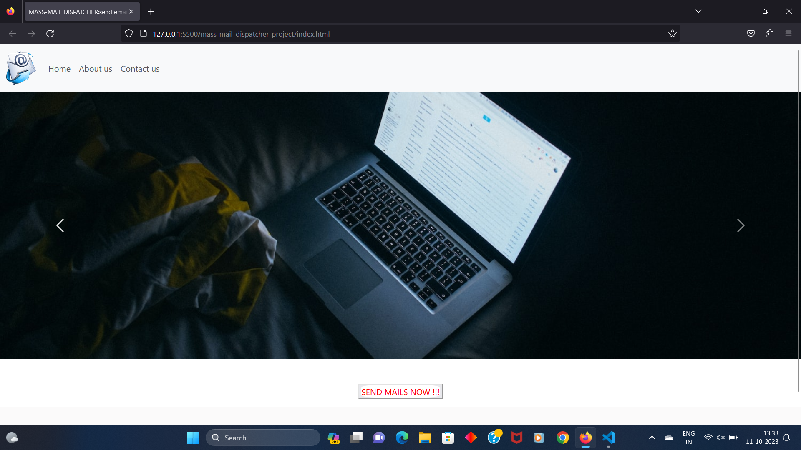

Slide 4
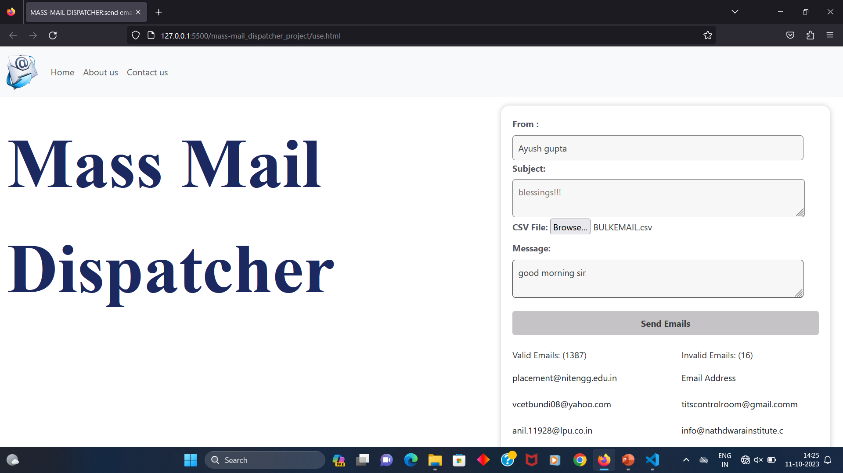
Inserting details:-

Slide 5
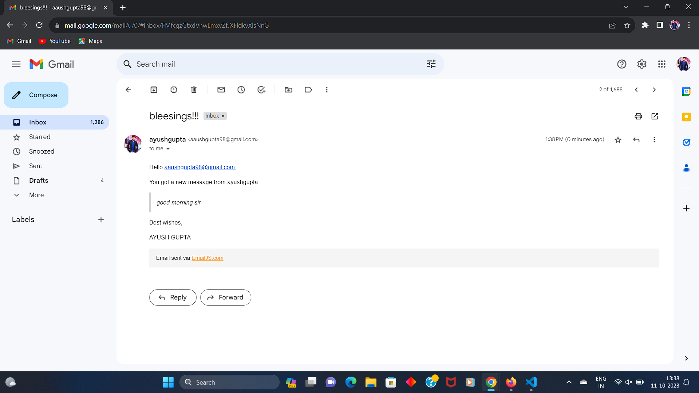
After Sending mail go to valid email address:-

Slide 6
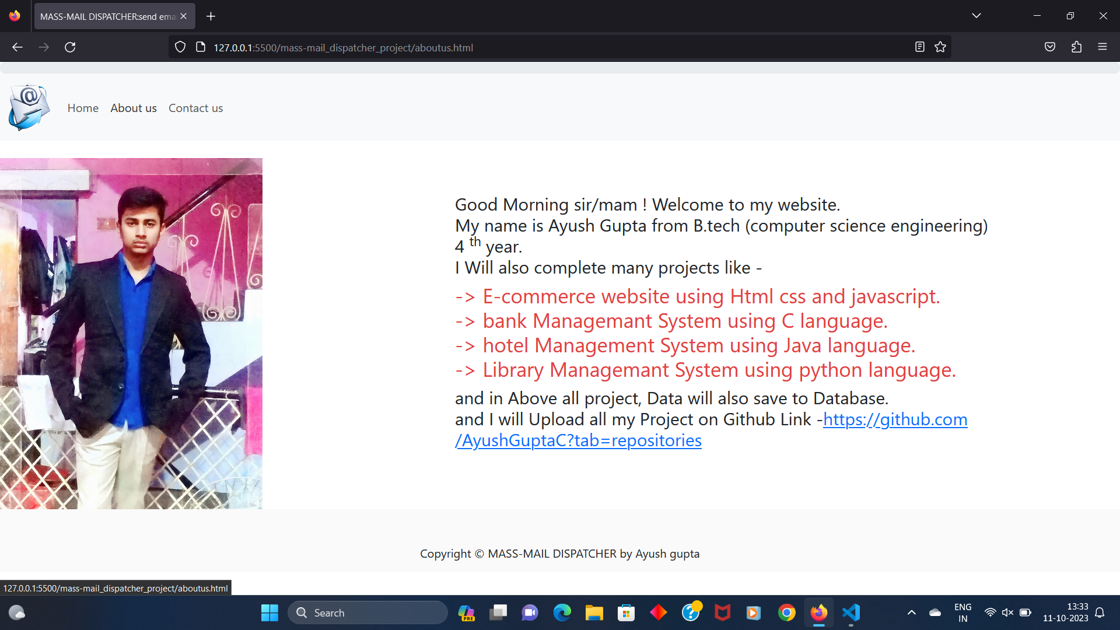
About us page:-

Slide 7
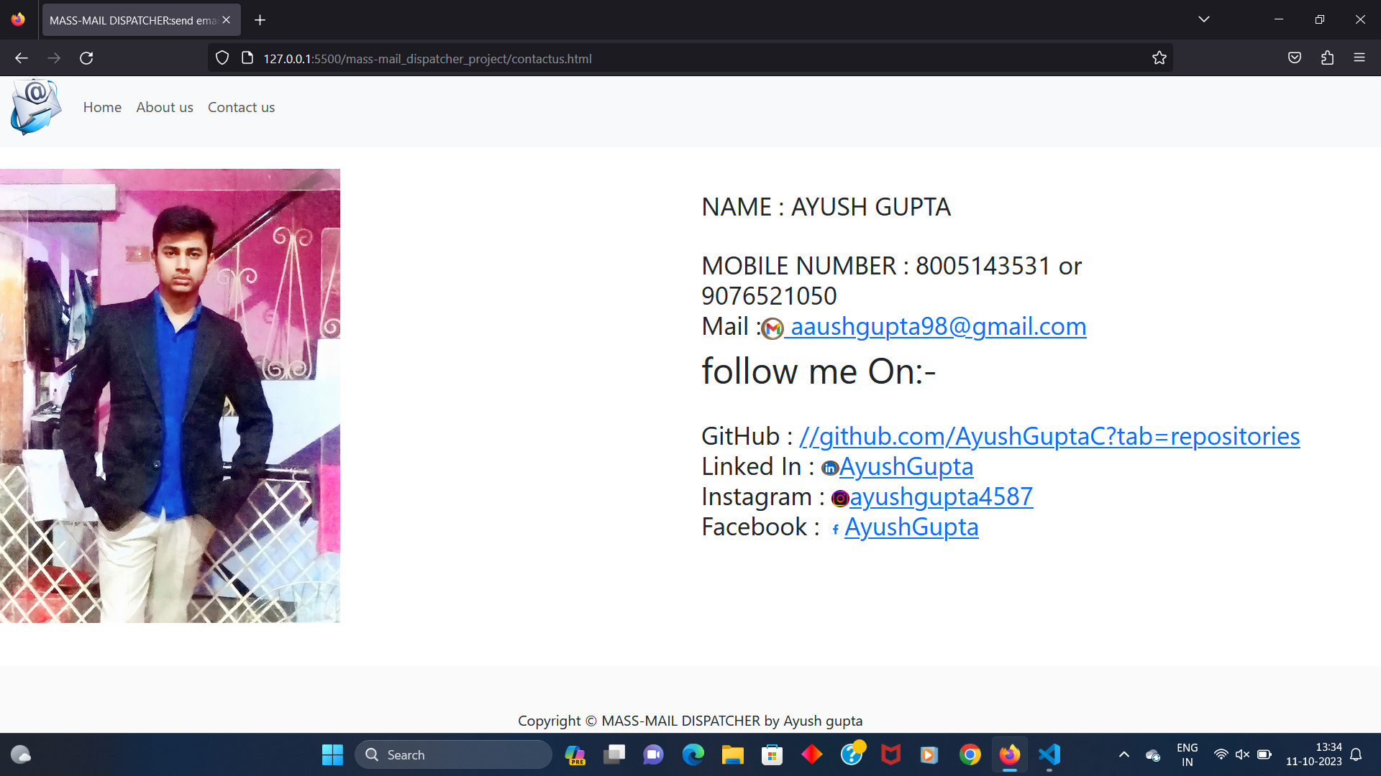
Contact us page :-

